Slide 1
Melting_point

Slide 2
Melting Point is the temperature at which a solid changes to a liquid.
State change
Physical change

Slide 3
Ice (solid water) has a melting point of 0°C.
Every substance has its own melting point.
For Example, copper has a melting point of 1,085°C.
Aluminum has a melting point of 660.3°C

Slide 4
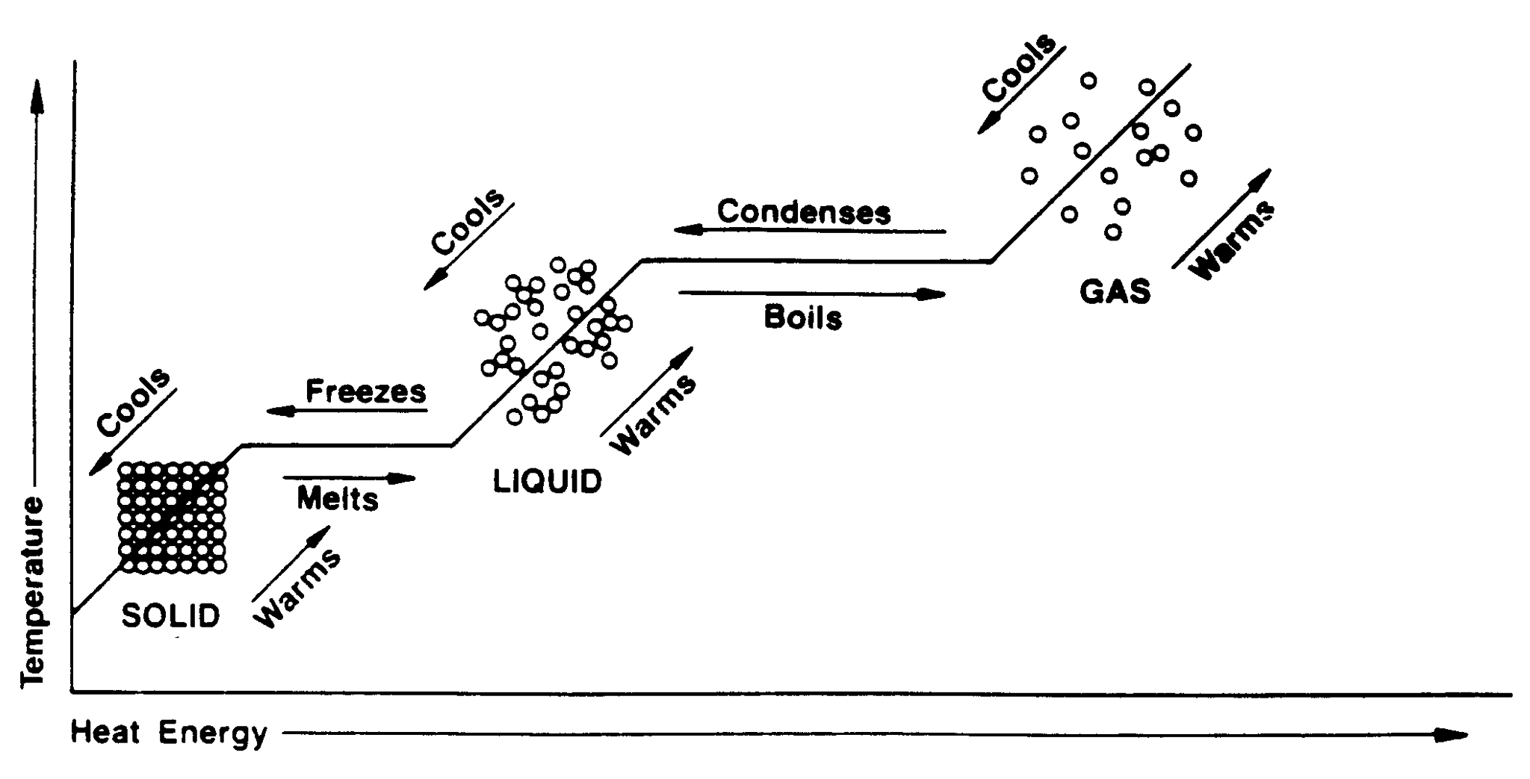
If enough heat energy is added to ice, it will reach 0°C and begin to melt.

Slide 5
