Slide 1
Ionic Bonds
Key Terms: valence electron, ion, ionic bond

Slide 2
Neutral Atoms
The number of protons(+) and the number of electrons(-) in an atom are the same.
The charges are balanced.
All atoms are neutral.

Slide 3
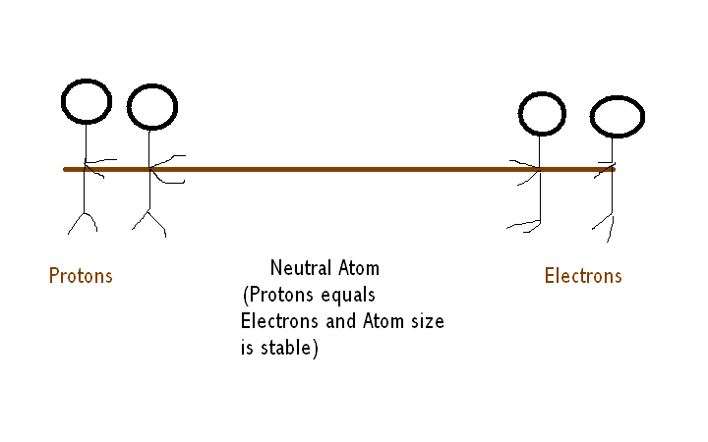

Slide 4
Valence Electrons
An electron in the outermost energy level of an atom is called a valence electron.
The maximum number of electrons that can be found in the outermost energy level is eight.
An atom with eight electrons in its outermost energy level is very stable.

Slide 5
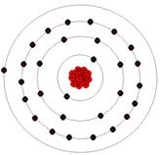
1. How can we determine the element below? 2. Locate the valence electron.

Slide 6
Ions
An ion is an atom with an electrical charge.
This happens when an atom loses an electron or gains an electron when atoms form chemical bonds.

Slide 7
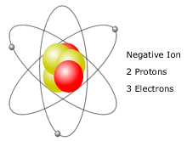
When an atom gains an electron, it becomes negatively charged. There are now more electrons than protons.

Slide 8
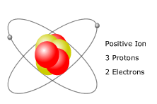
When an atom loses electrons, it becomes positively charged. There are more protons than electrons.

Slide 9
Ionic Bonds
An ionic bond forms between atoms that have gained or lost electrons.
The atom that loses electrons becomes a positive ion. The atom that gains electrons becomes a negative ion.

Slide 10
When two ions have separate charges, they are attracted to each other.
Just like magnets!
Opposites attract.
The force of attraction holds them together in an ionic bond.

Slide 11
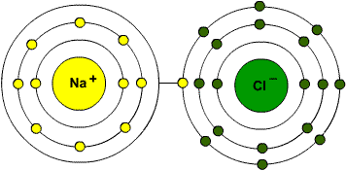
Sodium Chloride is an ionic compound. The sodium atom loses an electron and the chlorine atom gains an electron.

