Slide 1
Covalent Bonds
Key Term: Covalent Bond

Slide 2
Co – To share
Valence – outermost electrons
Covalent – share valence electrons!

Slide 3
In an ionic bond, atoms have to gain or lose an electron.
In a covalent bond, the atoms share electrons. Therefore, they do not become positively or negatively charged. The atoms remain neutral.

Slide 4
Compounds whose atoms share electrons in covalent bonds are called covalent compounds.
Water is an example of a covalent compound.

Slide 5
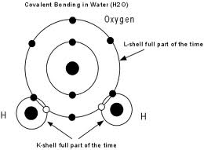

Slide 6
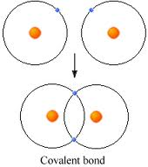
Example:

Slide 7
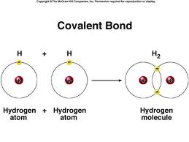
Example:

Slide 8
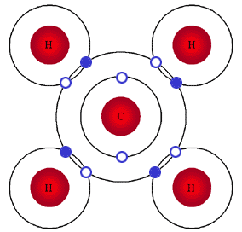
Example:

