Slide 1
Solutions
Solution – A mixture in which the particles of one substance are evenly mixed with the particles of another substance.

Slide 2
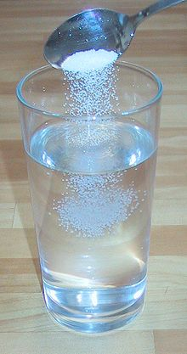
Let’s put some salt in water and stir:

Slide 3
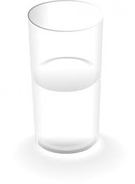
The salt dissolves in the water, forming a solution.

Slide 4
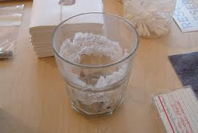
How could we separate the mixture of salt and water?

Slide 5
Parts of a Solution
Let’s look at our salt water solution:
The salt, which dissolves in the water, is called the solute.
The water is called the solvent, the substance in which the salt dissolves.
The solvent is usually present in the greater amount.

Slide 6
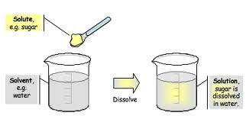
More Examples:

Slide 7
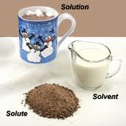

Slide 8
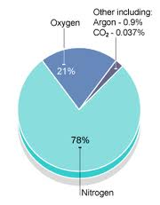
Air : Nitrogen is the solvent

Slide 9
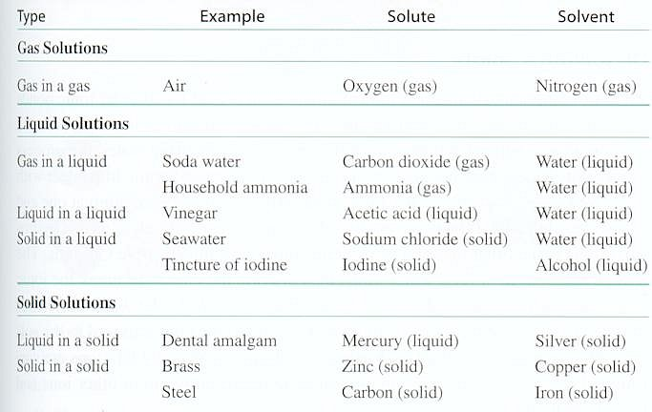
Types of Solutions See More on p.104, Figure 5-3

Slide 10
Soluble and Insoluble
A substance that will not dissolve in a given solvent, such as water, is insoluble in that solvent.
A substance may dissolve in one solvent but not in another solvent.

Slide 11
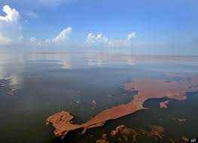
Oil is insoluble in Water

Slide 12
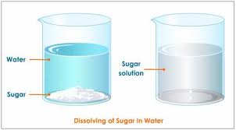
Sugar is soluble in water

Slide 13
Solubility
Solubility is the maximum amount of a substance that will dissolve in a given quantity of a solvent at a given temperature.

Slide 14
