Slide 1
Water: The Universal Solvent
Key Term: polar molecule

Slide 2
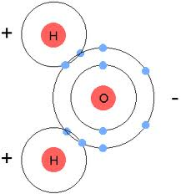
Water molecules are polar.

Slide 3
One end has a negative charge and the other end has a positive charge.
Why? The shared electrons spend more time closer to the oxygen part of the molecule than to the hydrogen part.

Slide 4
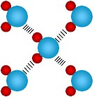
Each end of a water molecule is attracted to the opposite charged end of another water molecule.

Slide 5
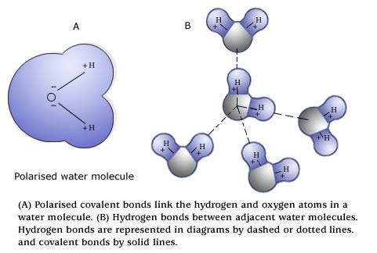

Slide 6
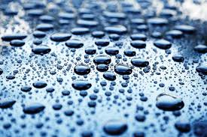
Water molecules are cohesive. This means that they tend to stick to each other, forming beads.

Slide 7
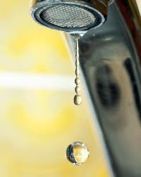

Slide 8
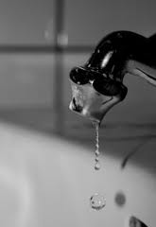

Slide 9
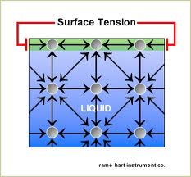
Strong cohesive forces at the surface of water is called surface tension.

Slide 10
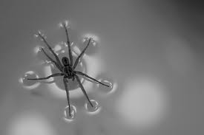

Slide 11
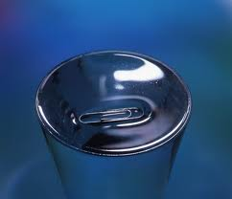

Slide 12
Water molecules are adhesive. An adhesive, such as a band-aid, sticks to our skin.
Water molecules stick to other things in addition to each other.

Slide 13
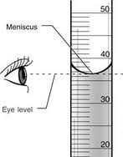
Meniscus – The water sticks to the sides of the graduated cylinder.

Slide 14
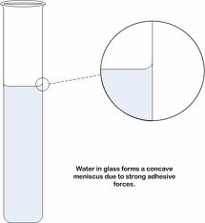

Slide 15
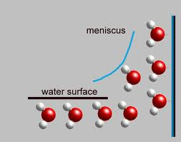

Slide 16
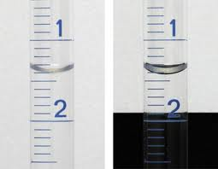

Slide 17
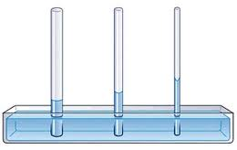
Capillary Action – Water is pulled upward, against the force of gravity.

Slide 18
In the previous picture, the water molecules stick to the sides of the tube (adhesion) and to each other (cohesion).

