Slide 1
Four Ways To Speed Up The Rate Of Dissolving:

Slide 2
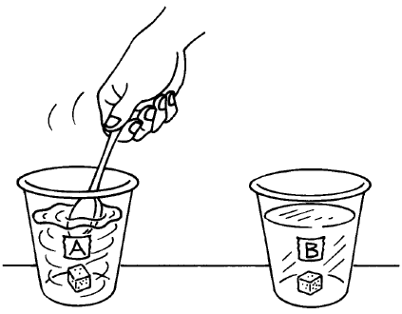
1-Stirring

Slide 3
2-Increase Temperature of the Solvent.
The increased temperature makes the water molecules move faster.
This increase in energy helps separate the solute faster.

Slide 5
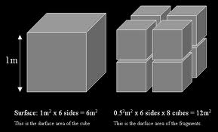
3-Increase Surface Area

Slide 6
4 – Increase Pressure
When pressure is increased, more gas is dissolved.
When you open a soda bottle, you can hear the gas escaping.
Carbon Dioxide has been added under high pressure.

Slide 7
