Slide 1
Dilute and Concentrated Solutions

Slide 2
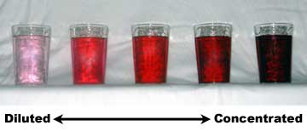

Slide 3
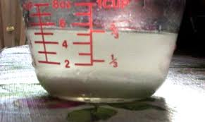
Saturated Solution

Slide 4
Supersaturated Solution
As the temperature of a solvent increases, so does the amount of a given solute it can hold.
After the solution is heated and more solute is added and dissolved, the temperature can then be lowered.
The solvent is now holding more solute than it can normally hold at that temperature. It is supersaturated.

