Slide 1
Matter
Matter – Anything that has mass and takes up space.
Mass is the amount of matter a sample of matter contains.
The amount of space the sample takes up is its volume.

Slide 2
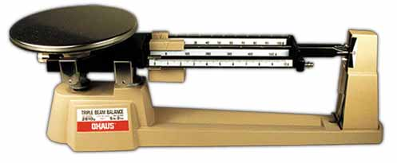
How will we determine mass?
We will determine mass by using a triple beam balance.

Slide 3
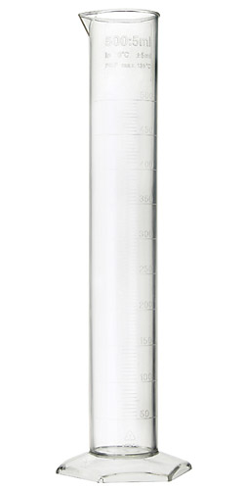
How can we determine volume?
We can determine volume by using a graduated cylinder.

Slide 4
Properties of Matter
Properties are characteristics used to describe an object.
Some of the properties that we will be using to describe matter are:
- Mass
- Volume
- Density
- Weight

