Slide 1
States of Matter
The most common states of matter are:
Solids
Liquids
Gases
*I say most common because we will not be learning about plasma.

Slide 2
Solids
Definite Shape
Definite Volume
The particles in a solid only move by vibrating in place. The particles cannot change position.

Slide 3
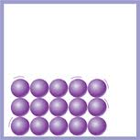

Slide 4
Liquids
NO Definite Shape
Definite Volume
The particles in a liquid CAN change position. This is why liquids can change shape.

Slide 5
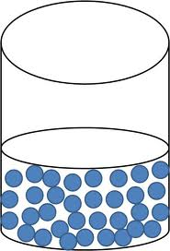

Slide 6
Gases
NO Definite Shape
NO Definite Volume
The particles in a gas move freely to all parts of a container it is in. A gas will take the shape of its container. Think of pumping air (a gas) into a soccer ball or football.

Slide 7
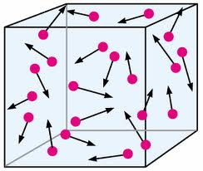

Slide 8
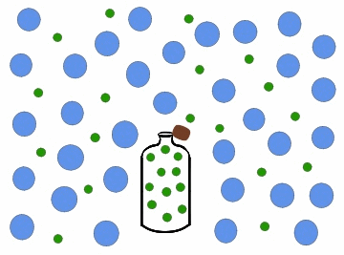

Slide 9
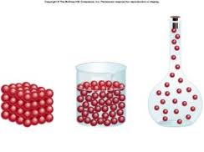
Solids, Liquids, Gases

Slide 10
