Slide 1
Matter Can Change State
State Change – A change in matter from one state to another
There are five possible state changes:

Slide 2
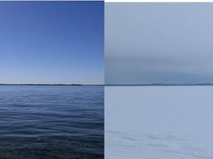
Freezing - Change from a liquid to a solid

Slide 3
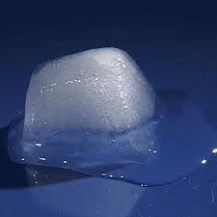
Melting – Change from a solid to a liquid

Slide 4
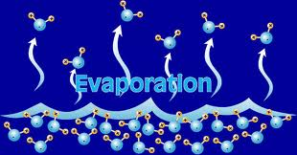
Evaporation – Change from a liquid to a gas at the surface of a liquid.

Slide 5
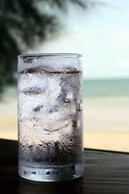
Condensation – Change from a gas to a liquid

Slide 6
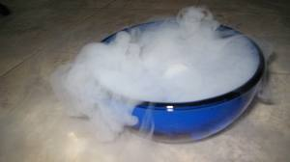
Sublimation – Change from a solid directly to a gas.

