Slide 1
Chemical Change
A chemical change is a change that produces a new substance.
Some examples:
gasoline burning
rusting of iron
digestion of food

Slide 2
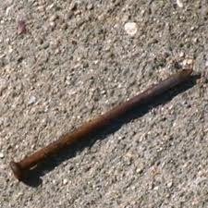

Slide 3
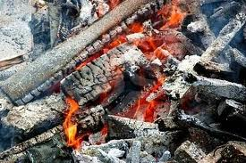

Slide 4
