Slide 1
Mixtures
The best example of a mixture is a salad !
A mixture is made up of two or more substances that are physically combined…..same thing with a salad.
Each part of the mixture keeps its own properties……same thing with a salad.

Slide 2
Two Types of Mixtures
Evenly Mixed – each part of the mixture will be identical. For example, the bottom part of a salt water mixture is the same as the middle and top.
Unevenly Mixed – One part of the mixture is different from another part. For example, one part of a salad may have more green peppers than another part.

Slide 3
Separating a Mixture
The parts of a mixture are not chemically combined. Therefore, the parts can be separated by physical means.

Slide 4
Evaporation
If we heat a mixture of salt and water, the water will evaporate and leave the salt behind.
Interesting…. There are several rivers and streams that feed into the Dead Sea, but none that drain out! Evaporation is the only way water is released from the sea. With the hot temperatures, the water evaporates fairly quickly. As this occurs, it leaves behind the salt!

Slide 5
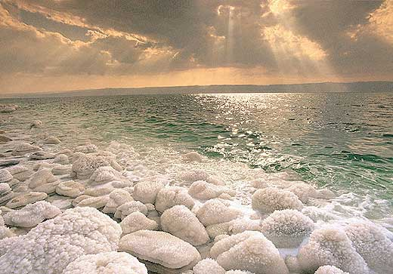

Slide 6
Filtration
If we have a mixture of sand and water, we can separate the two by filtration.

Slide 7
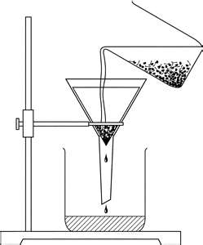

Slide 8
If one part of the mixture has magnetic properties, use a magnet!
For example, let’s say you have a mixture of sulfur and iron filings. Gliding a magnet over it will pull out all of the filings, leaving the sulfur behind.

Slide 9
