Slide 1
Conduction

Slide 2
Conduction is the transfer of heat in solids.
Why only solids?
The particles in a solid are close together.

Slide 3
If a solid is heated, the particles vibrate faster.
These particles have gained kinetic energy.
Therefore, the temperature increases.

Slide 4
We have learned that heat energy travels toward areas of lower temperature.
Faster vibrating particles bump the slower vibrating particles, making them move faster and gain heat energy.
So, when you heat a pot on the stove, the heat is transferred from the bottom, through the metal, to the top.

Slide 5
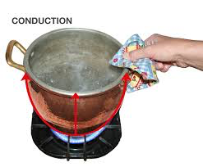

Slide 6
