Slide 1
CONVECTION
Convection is the transfer of heat in liquids and gases.
This transfer is due to the density differences in those liquids and gases.

Slide 2
When liquids and gases are heated, the particles move faster and farther apart.
Since the particles are moving further apart, the heated liquid or gas becomes less dense.

Slide 3
Decrease in density:

Slide 4
Convection Currents (Cells)
Just like a hot air balloon, air itself rises when it is heated.
The warmer, less dense air rises. Cooler, denser air takes its place.
This process forms what we call a convection cell.

Slide 5
In a convection cell, heat is carried.
As the heated gas or liquid moves, the heat is carried with it.
See the following picture:

Slide 7
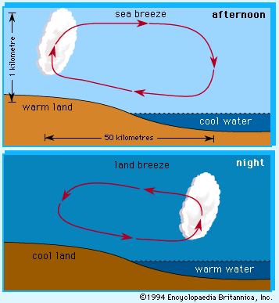

Slide 8
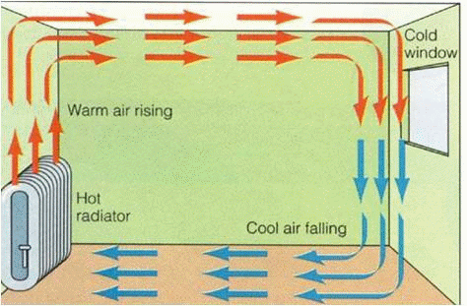

Slide 9
