Slide 1
Elements and Atoms
Elements
Elements are substances that cannot be chemically broken down into simpler substances.
All matter on Earth is made up of elements or combinations of elements.

Slide 2
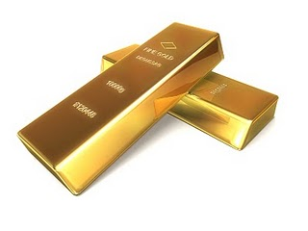
Gold is an element.

Slide 3
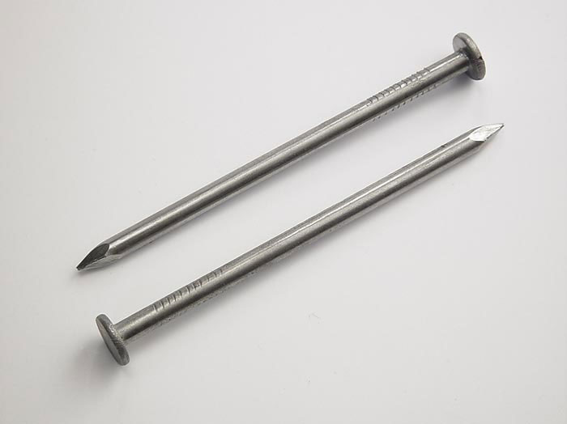
So is the Iron that makes up these nails!

Slide 4
Some types of matter can be made up of more than one element.
One example is the water we drink. In water, we find the elements:
Hydrogen
Oxygen

Slide 5
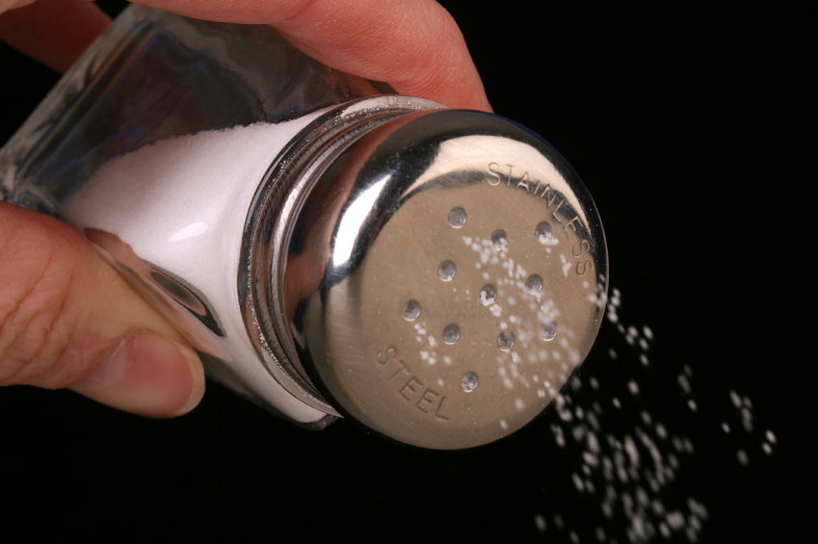
Another is typical table salt.

Slide 6
Table Salt
Sodium
Chlorine
These elements combined give us sodium chloride……..table salt!

