Slide 1
Atoms
Atoms
An atom is the smallest part of an element that can be identified as that element.
Think about this: It is not possible to divide matter forever. At some point you will reach the smallest possible piece. The smallest piece: an atom!

Slide 2
The Parts of an Atom
Nucleus – The center of the atom.
Proton – Inside the nucleus. Has a positive (+) charge.
Neutron – Inside the nucleus. Has no charge.
Electron – Outside of the nucleus….surrounds the nucleus. Negative (-) charge.

Slide 3
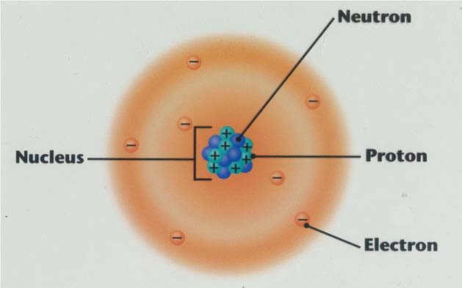
Model of a Nitrogen Atom

Slide 4
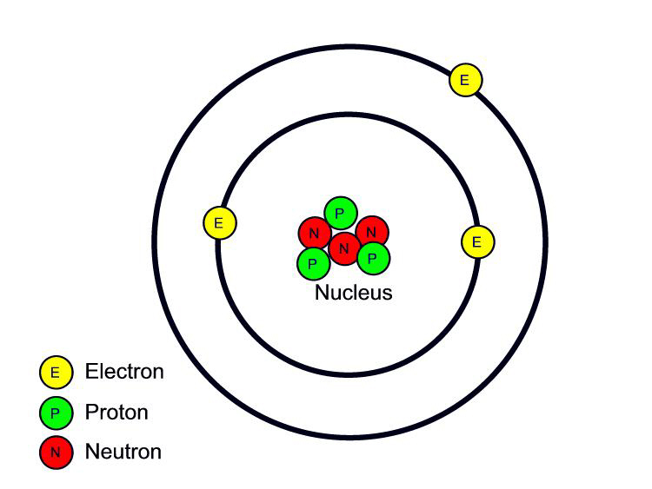
Model of a Lithium Atom

Slide 5
Atomic Number
Atomic Number - the number of protons found in the nucleus of an atom.
Each element has a different atomic number.
To find the number of protons, just look at the atomic number!

Slide 6
Examples :
Hydrogen
- Atomic Number: 1
- This tells us that The number of protons in the nucleus of a hydrogen atom is 1.

Slide 7
Oxygen: - Atomic number: 8 - The number of protons in an atom of oxygen is 8
Just as we all have a fingerprint that identifies us, the atomic number of an element identifies that element.
No two elements have the same atomic number!

Slide 8
Atomic Number and Electrons
We already learned that the number of electrons is the same as the number of protons.
We also learned that the atomic number tells us the number of protons.
So….If you know that the atomic number is 79, that means that there are 79 protons and 79 electrons.

