Slide 1
Electron Arrangement
The area around the nucleus where electrons are found is called the electron cloud.
Electrons are arranged in energy levels .
Each energy level is a different distance from the nucleus.
As we move further from the nucleus, the energy level increases.

Slide 2
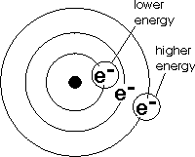

Slide 3
Each energy level can hold only a certain amount of electrons:
Energy Level Electron Capacity
1st 2 electrons
2nd 8 electrons
3rd 18 electrons
4th 32 electrons

Slide 4
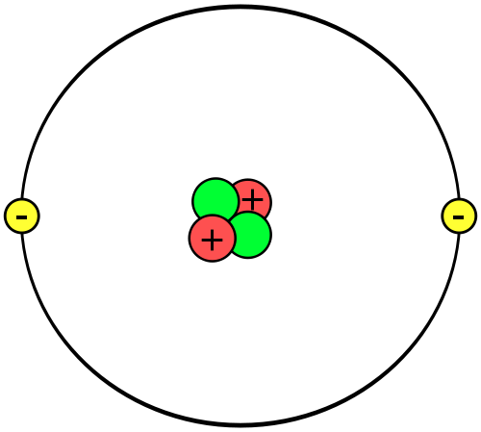
Helium Atom: 2 protons, 2 neutrons, 2 electrons

Slide 5
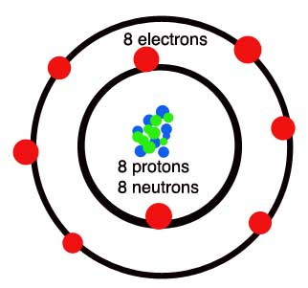
Oxygen Atom: The first level can hold only two electrons. The remaining six are on the 2nd energy level.

Slide 6
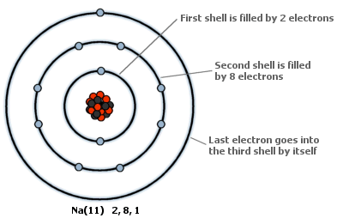
Sodium Atom

