Slide 1
Metals and Nonmetals
The zigzag line at the right side of the Periodic Table separates the metals on the left (the exception is hydrogen)from the nonmetals on the right.

Slide 2
Properties of Metals:
Luster – The ability to reflect light. Some metals are shiny.

Slide 3
Malleable - Most metals can be hammered into thin shapes and different shapes.
Ductile – Metals can be made into thin wires.
Some metals are good conductors of electricity. This means that electricity will move through easily.

Slide 4
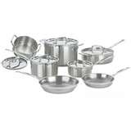
Most metals are good conductors of heat. Heat moves through easily. This is why pots and pans are made of metal.

Slide 5
Nonmetals
Look dull, not shiny like metals are.
Brittle, easily broken
Poor conductors of heat and electricity.
Not malleable and ductile.
But they are Useful! For example, air has nitrogen, oxygen, and other elements!

