Slide 1
Air Resistance
The force that opposes the movement of an object in air.
The greater the surface area of an object, the greater the air resistance.

Slide 3
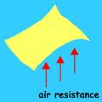

Slide 4
Vacuum
Empty Space
The Moon has no atmosphere. There is no air resistance.
If we dropped the crumpled piece of paper and the uncrumpled piece while standing on the moon, they would both land at the same time.

Slide 5
Terminal Velocity
Speed at which air resistance and gravity acting on a falling object are equal.
The upward force of air resistance becomes equal to the downward pull of gravity.

