Slide 1
Bernoulli’s Principle
As the speed of a fluid increases, its pressure decreases.
Liquids and gases are fluids.

Slide 2
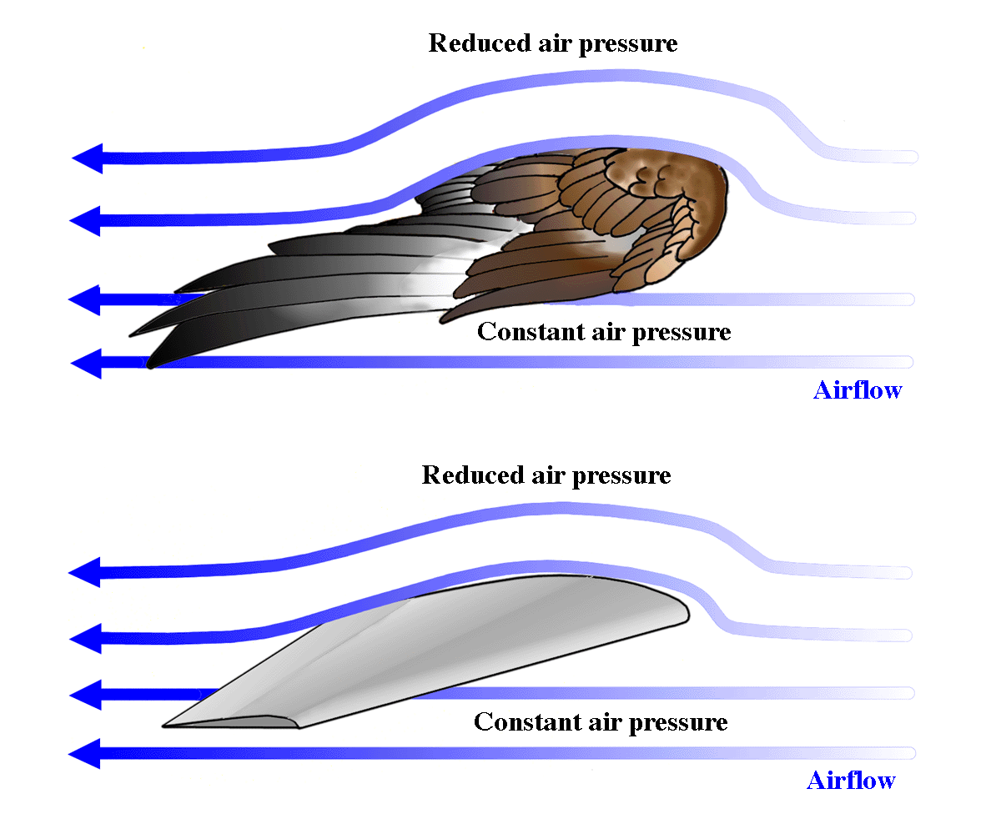
Airplane wings are designed to use this principle:

Slide 3
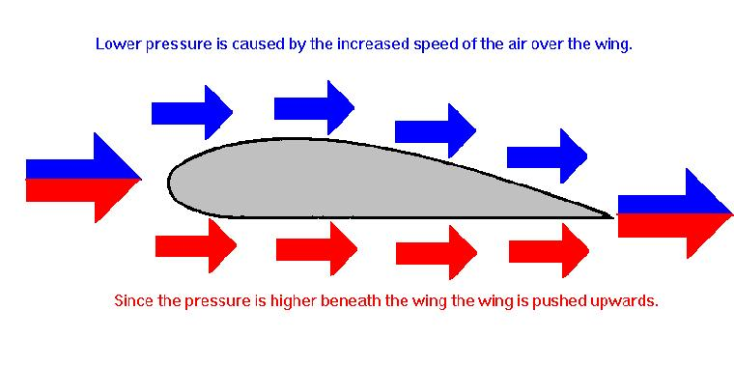

Slide 4
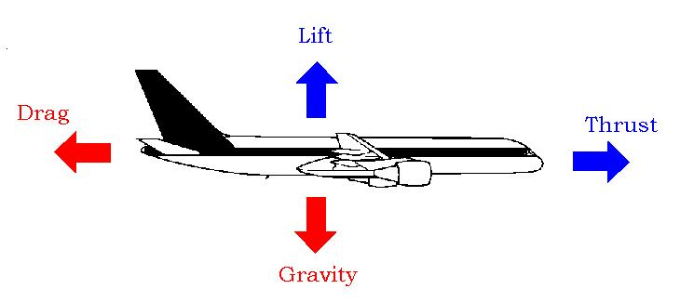
Four forces that act on an airplane:

