Slide 1
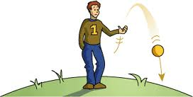
FORCES

Slide 2
Force
A force is a push or a pull.
Example: Earth’s gravity pulls objects down.
In the previous picture, two forces occur:
1 - The boy throws the ball up - PUSH.
2 – The Earth’s gravity PULLS the ball down.

Slide 3
Direction
A force is always in some direction.
When you push a chair, the force is in the direction of the push.
When you pull open a door, the force is in the direction of the pull.

Slide 4
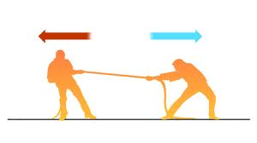
Balanced forces
Equal in size but opposite in direction

Slide 5
