Slide 1
Gravity
The force of attraction between all objects in the universe.

Slide 2
Two things determine gravitational pull between objects:
Distance
Mass

Slide 3
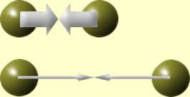
Distance and Gravity

Slide 4
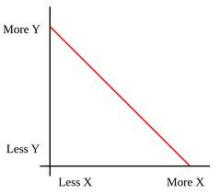
Relationship is Inverse

Slide 5
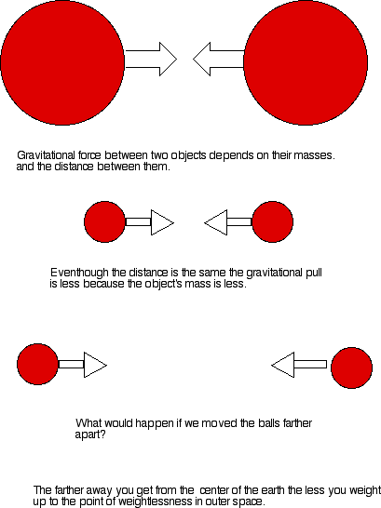
Mass and Gravity

Slide 6
Relationship is Direct

