Slide 1
Freezing Point
This is the point at which a liquid changes to a solid.
A liquid changing to a solid is a state change.
A state change is a physical change.

Slide 2
Water
Water’s freezing point is 0⁰ Celsius
Mercury has its own freezing point of -39⁰ Celsius.
All liquids have their own freezing point.

Slide 3
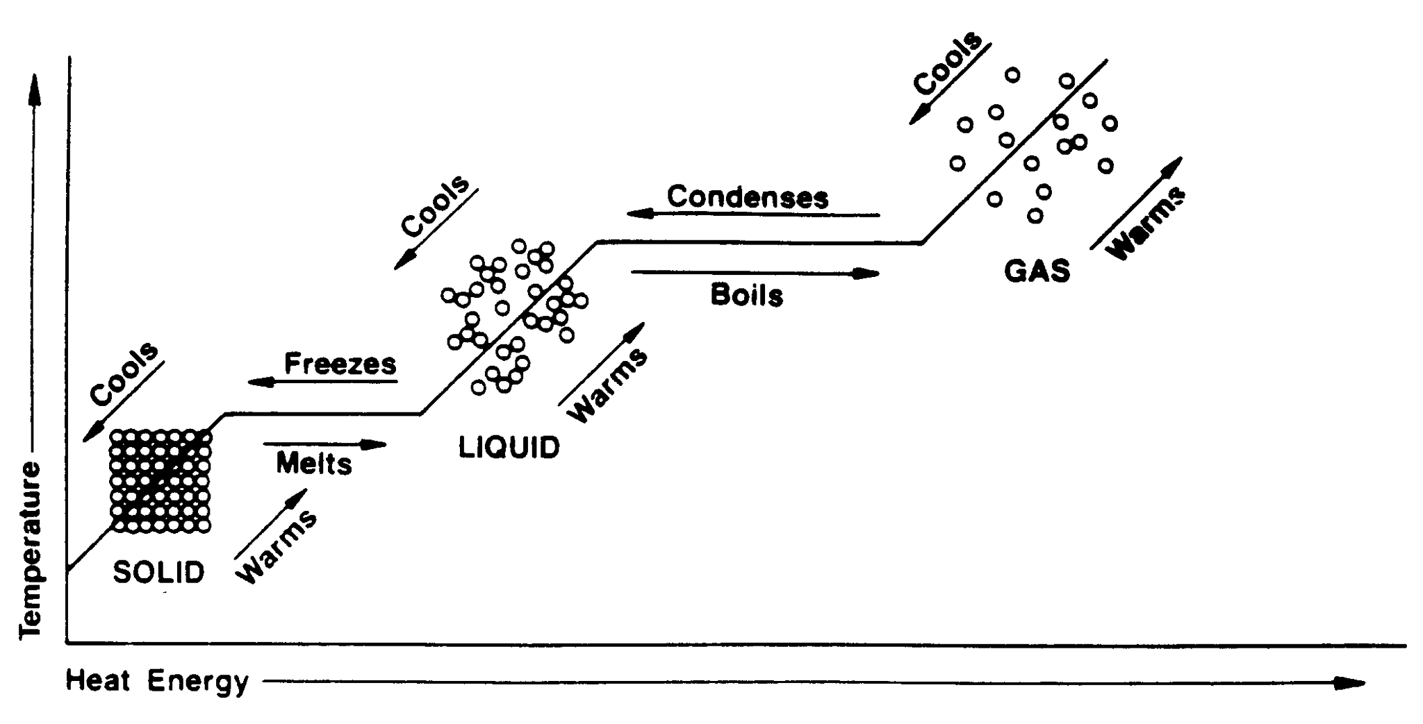
If enough heat is removed from water, then it will freeze.

Slide 4
QUESTIONS:
At what temp. does water begin to freeze?
What happens to the heat energy as water decreases in temperature?
What happens to the temp. during freezing?
What about after freezing is done?

Slide 5
Absolute Zero
Absolute Zero is NOT the same as 0°C.
Actually, Absolute Zero is equal to -273°C.
Absolute Zero would be reached if all motion of the particles in a sample of matter stops.
As of this date, it has been impossible to reach.

