Slide 1
Wave Frequency
Wave Frequency
A certain number of waves pass a point in a given amount of time.
The number of complete waves per unit of time is called the frequency.
Frequency is measured in waves per second.

Slide 2
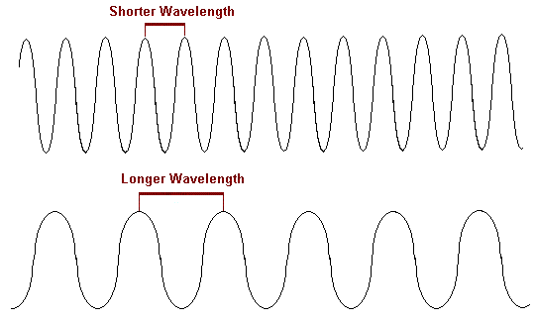
Which wave has the lower frequency?

Slide 3
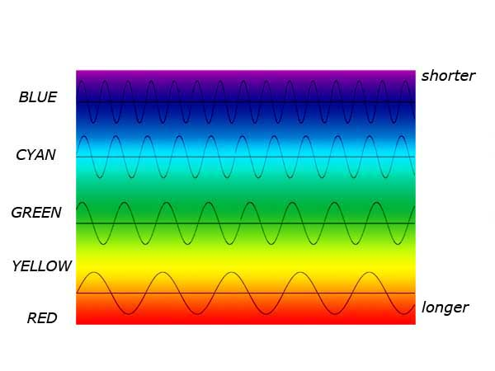
What is the relationship between wavelength and frequency?

Slide 4
As wavelength decreases, frequency increases.
As wavelength increases, frequency decreases.

