Slide 1
Heat
Heat is the energy of particles moving in matter.
Heat moves from a warmer region to a cooler region.

Slide 2
Hot
Cold
Heat

Slide 3
All Matter has heat
The particles ( atoms and molecules) are always moving.
For Example:
-The particles that make up ice are vibrating in place.
-The particles in your water bottle slide past each other.

Slide 4
Temperature
Kinetic Energy is the energy of motion.
Temperature is a measure of the average kinetic energy (motion) of all the particles in a sample of matter.

Slide 5
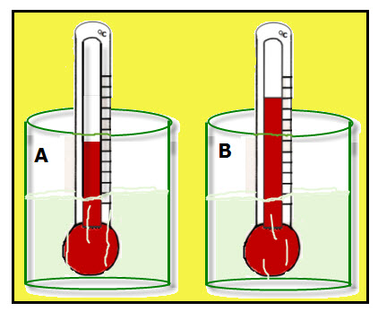
Kinetic Energy
Substance a has less kinetic energy. The particles are moving slower.
Substance b has more kinetic energy. The particles are moving faster.

