Slide 1
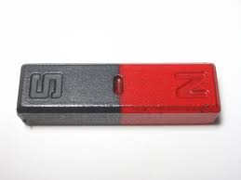
MAGNETISM

Slide 2

What is a magnetism?
Magnetism is a force of attraction or repulsion by magnetic materials.

Slide 3

What elements are attracted to a magnet?
Iron, nickel, and cobalt are attracted to magnets….but wood, glass, and plastics are not.

Slide 4
Magnetic Poles
Each end of a magnet is called a pole.
Every magnet has two poles:
North Pole
South Pole
Magnetic forces are strongest at the
poles.

Slide 5

Opposites Attract!
The North Poles and South Poles are attracted to each other.

Slide 6

Like Poles Repel!
A north pole pushes away a north pole. A south pole pushes away a south pole.

