Slide 1
Motion
Motion is a change in position relative to some fixed object or place.

Slide 2
On your way to school this morning, you were in motion!
Obvious, yes, but what if we have to prove it?
Well, the distance between yourself and the school (fixed position) kept changing.

Slide 3
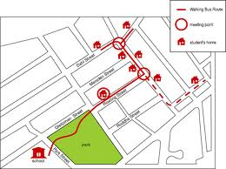
As the bus picks up students, its position relative to the school is always changing.

