Slide 1
Momentum
Momentum is the combined effect of the mass and velocity of an object.

Slide 2
The Law of Conservation of Momentum
This law states that momentum can be transferred but cannot be lost.

Slide 3
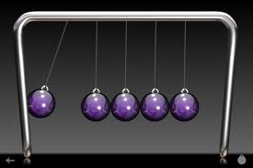
Newton’s Cradle

