Slide 1
Observations and Inferences
Warmup?
Look at the drawing.
What do you notice and what do you think happened?

Slide 2
Observations and
Inferences
How does your story change?

Slide 3
Observations and
Inferences
How does your story change?

Slide 4
Observations and
Inferences
What do you observe?
What do you infer?
Compare what you think now
to your earlier written accounts.

Slide 5
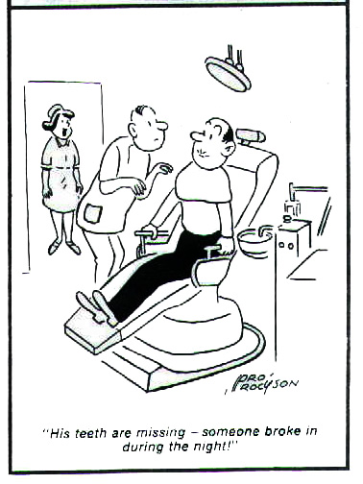
Observations and Inferences
Observations are what you notice
Inferences are your reactions, thoughts or explanations

Slide 6
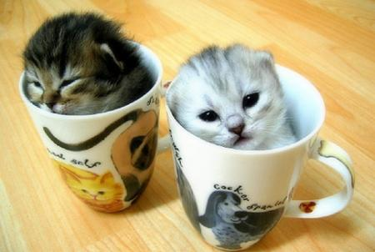
Write one observation.
Write one inference

Slide 7
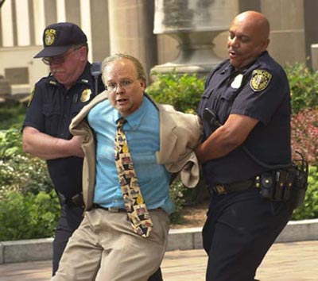
Write one observation.
Write one inference

Slide 8
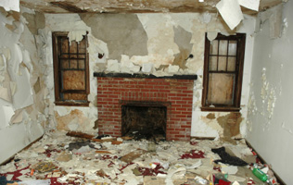
Write one observation.
Write one inference

Slide 9
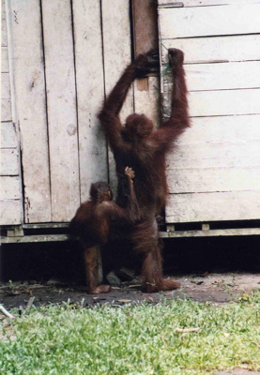
Write one observation.
Write one inference

Slide 10
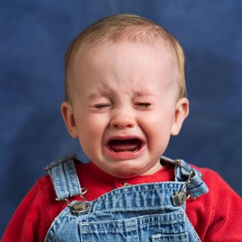
Write one observation.
Write one inference

Slide 11
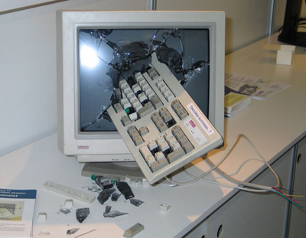
Write one observation.
Write one inference

Slide 12
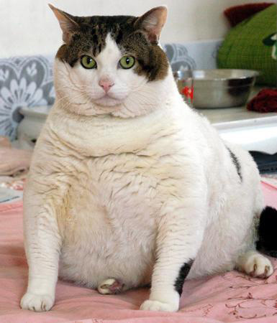
Write one observation.
Write one inference

Slide 13
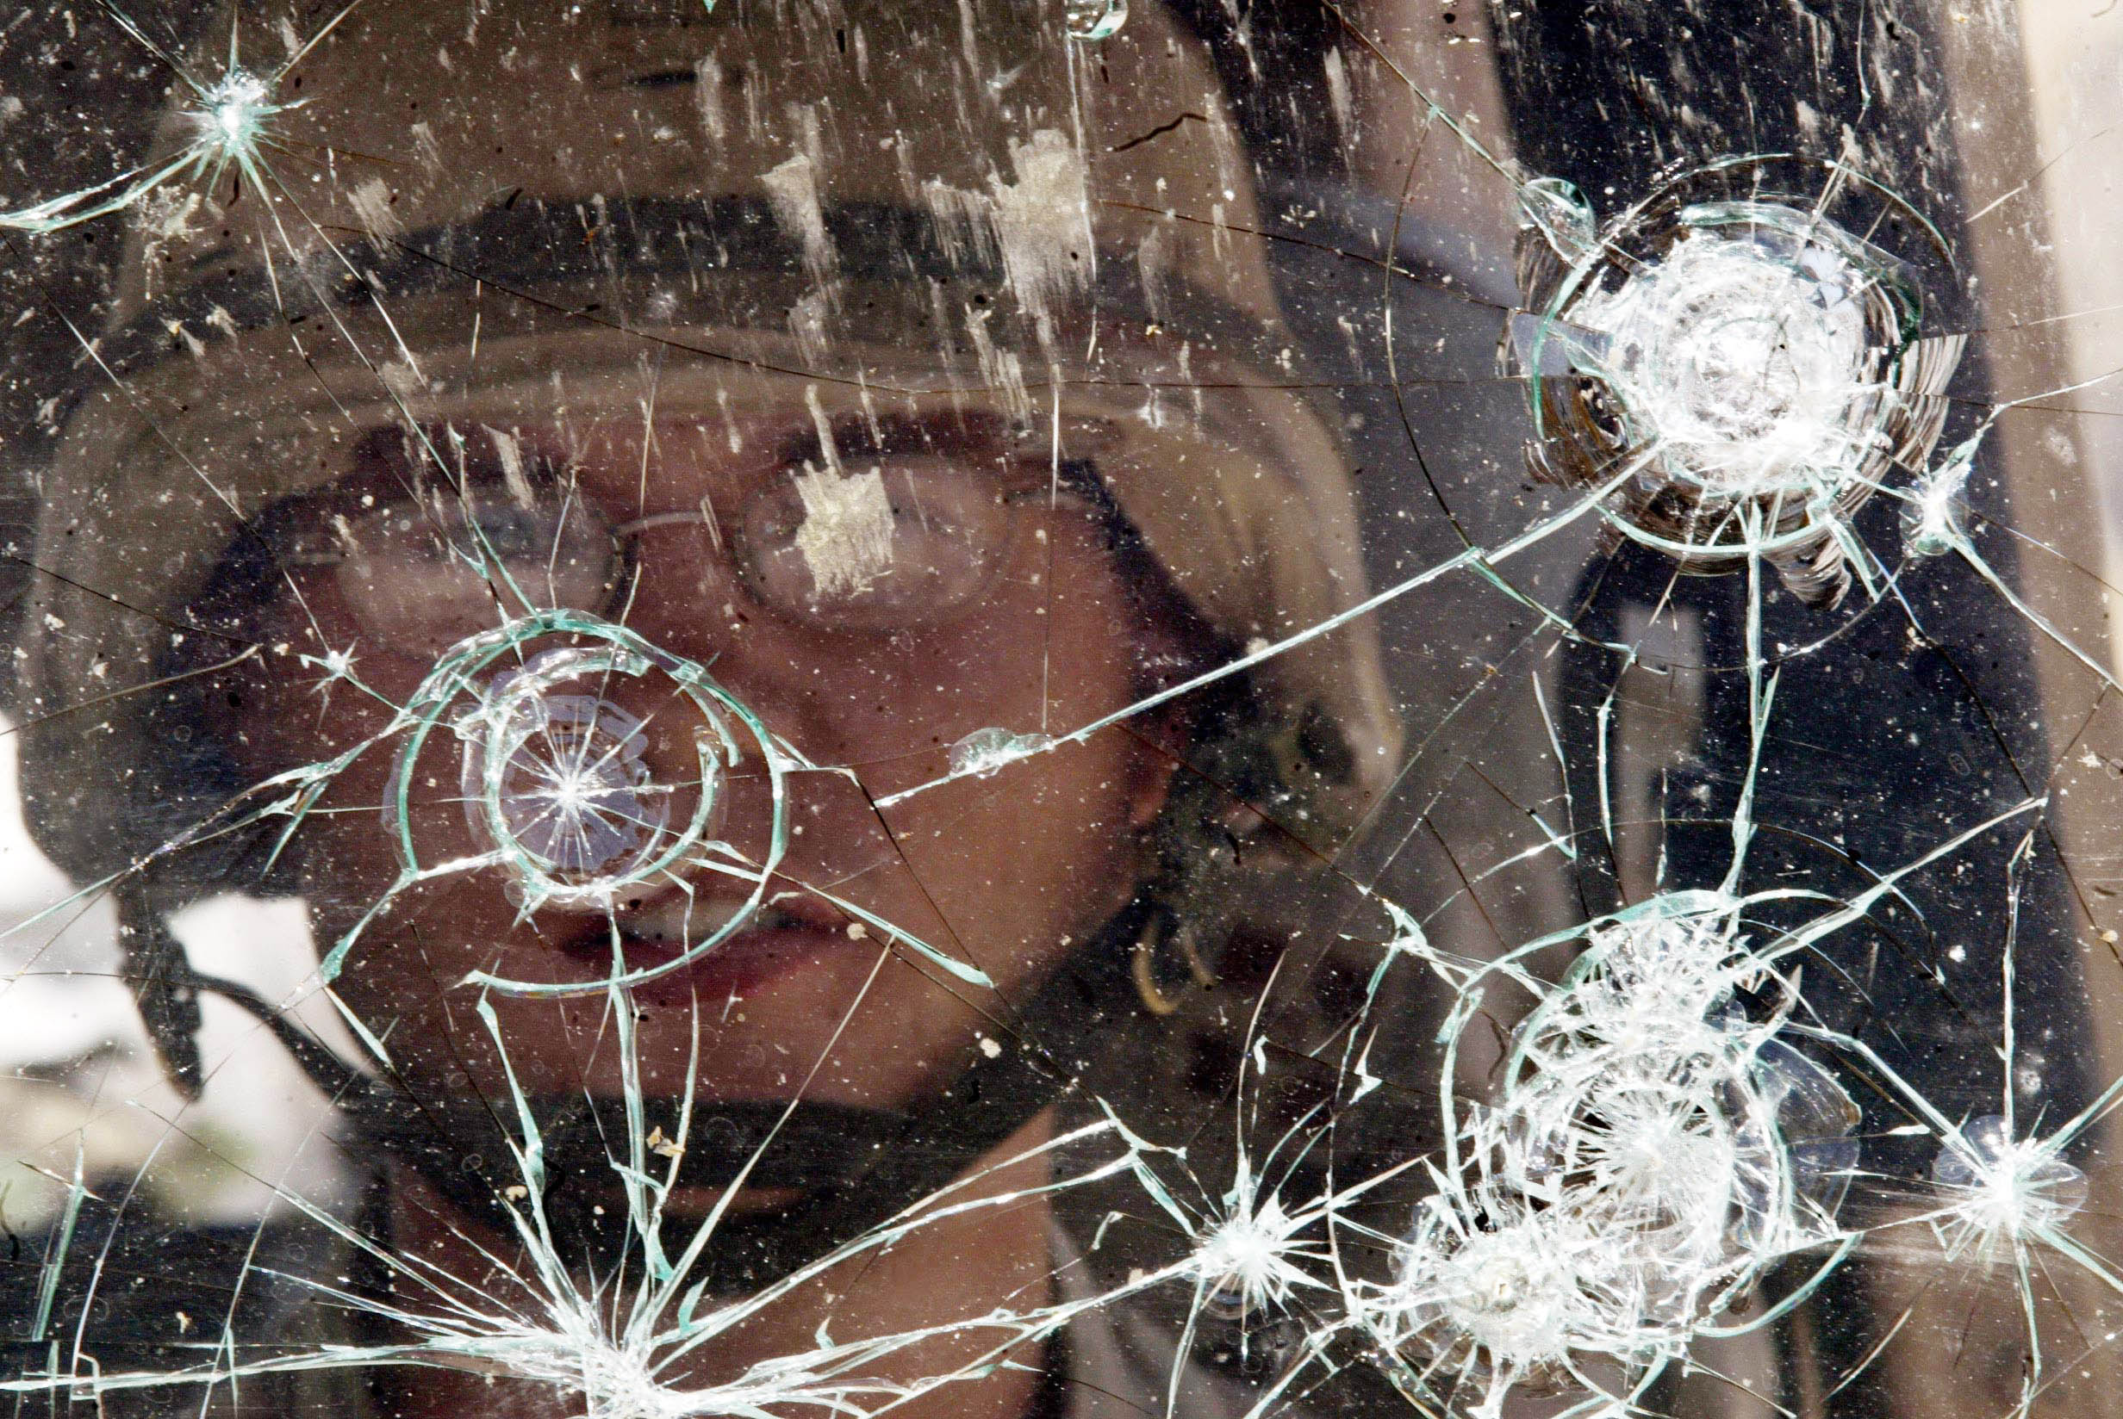
Write one observation.
Write one inference

Slide 14
Quantitative vs Qualitative
Quantitative observations are ones that are based on a QUANTITY.
These would be measurements.
Weight
Height
Length
Qualitative Observations.
These are based on characteristics.
Color
Size
Texture

Slide 15
Summary
What is the difference between an observation and an inference.
What is the difference between a quantitative observation and a qualitative observation.
How can people have different inferences about the same observations.

Slide 16
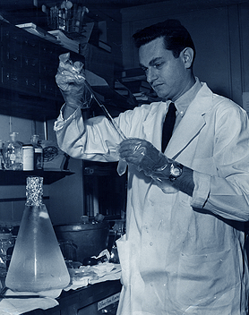
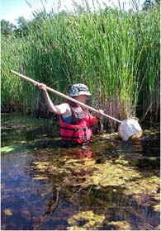
Scientific Method
Scientists do two main types of studies.
Experimental Observational
Control, Test
Study, Observe, analyze

