Slide 1
Reading a Graduated Cylinder
Determine Scale (What is each line worth?)
Measure bottom of meniscus
Get to eye level

Slide 2
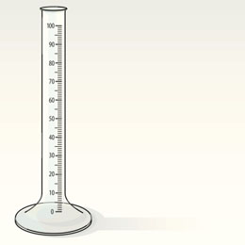
Scale
Take two numbered lines that are next to each other and find their difference.

Slide 3
Divide that by the number of spaces between our two numbers.

Slide 4
This tells us what each line is worth.

Slide 5
Meniscus
Water tends to stick to the sides of the graduated cylinder. This is called adhesion. ( A band-aid sticks to you, we call it an adhesive).
This force of adhesion is a little stronger than the force of cohesion between each water molecule.

Slide 6
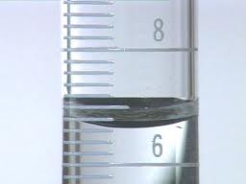
The water takes on a curved shape called a meniscus.

Slide 7
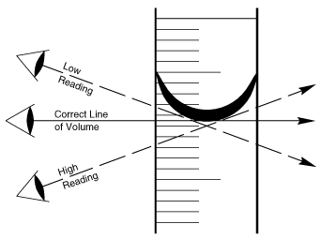
Always get eye level and read the bottom of the meniscus……..the bottom of the curve.

