Slide 1
Sound Waves
How do sound waves travel?
Sound waves travel as longitudinal waves.

Slide 2
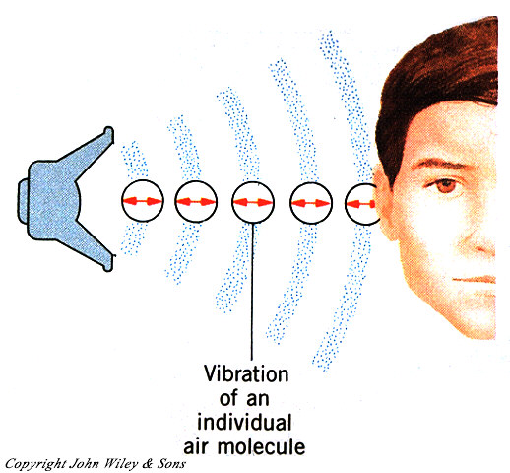

Slide 3
What causes sound waves?
Sound waves are caused by vibrations.
A vibration is a back-and-forth movement.
As we speak, we can touch our vocal chords and feel vibrations.

Slide 4
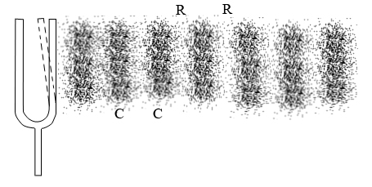
For every sound we hear, some object is vibrating!

