Slide 1
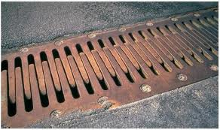
Thermal Expansion

Slide 2
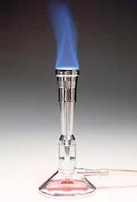
What is thermal expansion?
Thermal expansion is the expansion of matter caused by heating.

Slide 3
Remember the two F’s: Particles
move faster and farther apart when
heated.
When a material is heated, it expands.
This expansion occurs even when the
material does not change its state of matter.

Slide 4
When a material cools, the opposite
occurs.
The particles move slower and get closer
together.
The material contracts (gets smaller).

Slide 5
Does thermal expansion occur in solids, liquids and gases?
Thermal expansion occurs in all three of these states.

Slide 6
What about water when it changes to ice?
This is an exception to our rule for cooling and contraction. Water contracts
When it is cooled. However…..

Slide 7
When water is cooled down to freezing point, it suddenly begins
to expand and turn into ice.
We see this when we pour water
into a tray to make ice cubes. We
pour in enough so it doesn’t spill
over the sides. However, hours later the ice expands to become higher than the tray itself.

