Slide 1
Types of Waves
What are the two types of waves?
Transverse
Longitudinal

Slide 2
Transverse Wave
In a transverse wave, the particles of the medium move up and down at right angles to the direction of motion of the wave.

Slide 3
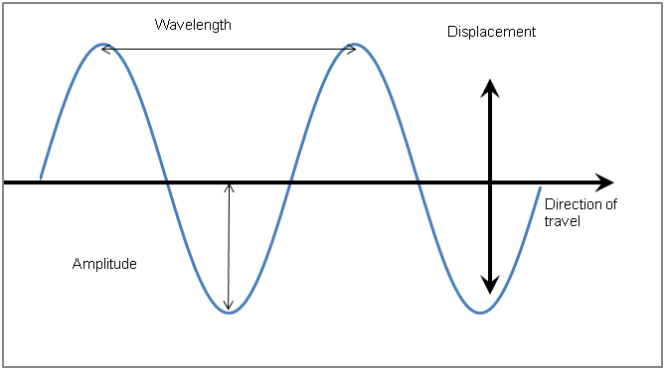

Slide 4
Longitudinal Wave
A longitudinal wave is a wave in which the particles of the medium move back and forth in the direction of the wave motion.

Slide 5
